Slide 1
Data analysis project presentation
Team MEMBER
Haitao ZHOU(HAZ59)
Yingzhi Yang(yiy50)
Xin jin(xij21)

Slide 2
INTRODUCtion
The project is Home Depot Product Search Relevance in Kaggle Competition.
We need to predict the search result relevance by creating a predict model using the data produced by Home Depot.

Slide 3
Preparing data
1. Merge Product_descriptions.csv to Train.csv and Test.csv by product_uid
2. Tm package in R
Remove stopwords
Strip white space
Stem document ( language = “english”)
Lower case(tolower)
Remove punctuations
3. Clean text
Change “°” to “degree”
Change “v” to “volts”
4. TF-IDF
Change data frame source to vector source
Weight term document matrix by Term Frequency – Inverse Document Frequency

Slide 4
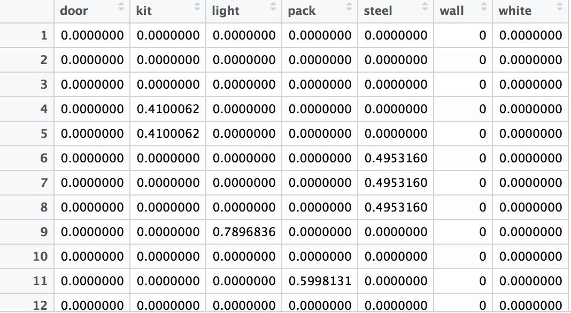
Weight of words in Product_title

Slide 5
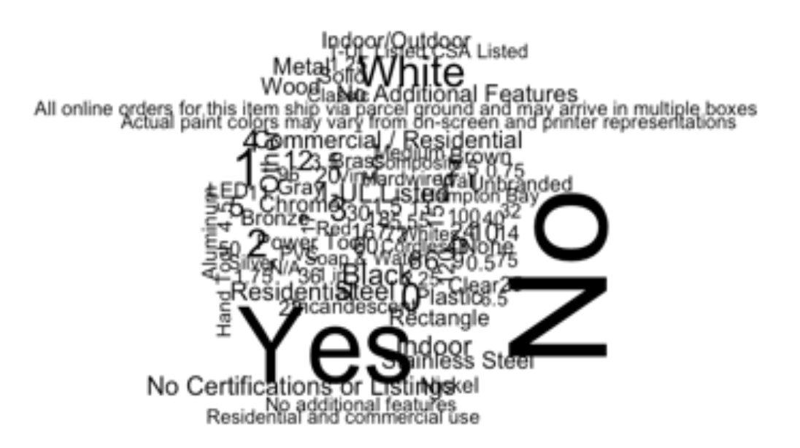
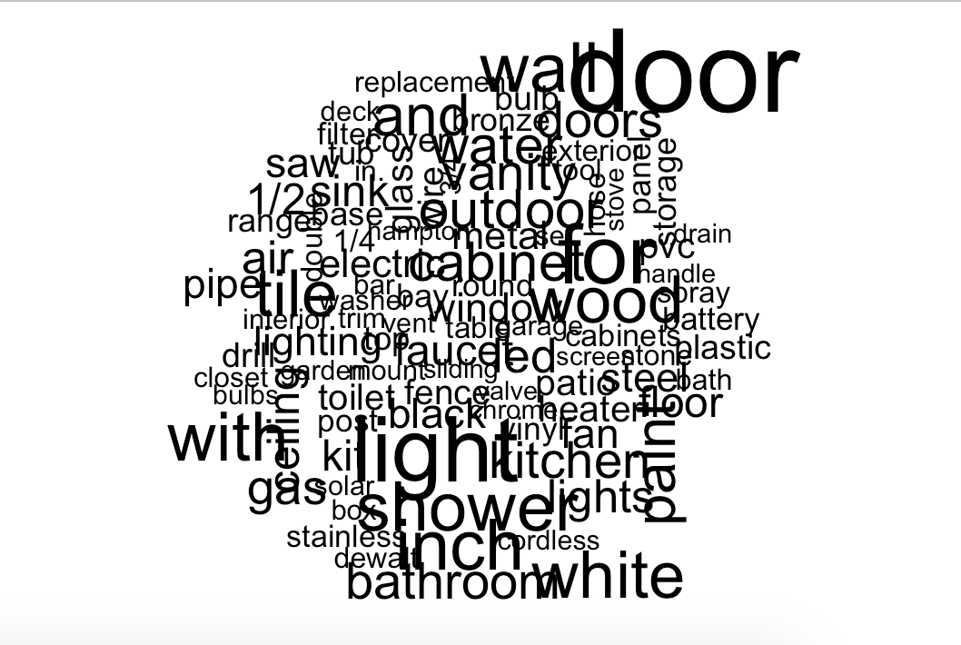
Word cloud

Slide 6
Models
1. LM: used to fit linear model
Result in Kaggle: 0.51144
2. SVM: used to train a support vector machine
Result in Kaggle: 0.51414
3. RPART: Recursive partitioning for classification, regression and survival trees
Result in Kaggle: 0.51481

Slide 7
GBM Model
GBM model is an implementation of extensions to Freund and Schapire's AdaBoost algorithm and Friedman's gradient boosting machine.
Parameters:
Distribution: “beroulli” for classification problem, “gaussian” for regression problem
N.trees: number of iterations
Interaction depth: depth of decision tree
Shrinkage: speed of learning

Slide 8
GBM results
Distribution | Interaction depth | Shrinkage | N.trees | Result
gaussian | 2 | 0.05 | 500 | 0.50303
gaussian | 3 | 0.05 | 1000 | 0.50267

Slide 9
conclusion
After testing several models, we found that the result of GBM model beat the others. Different parameters in the model led to different results. To find the best result, we can raise the iteration number and the depth of decision tree.

Slide 11
limitation
Since data in attribute.csv is complex and uniform, we still not find a good method to figure out how it influence the relevance of query.

Slide 12
Thank you!

